Slide 1
Kalaiyarasi.M
Final Project
3/21/2024 Annual Review

Slide 2
OBJECT DETECTION USING OPENCV
3/21/2024 Annual Review

Slide 3


AGENDA
Problem Statement
Project Overview
Who are the end users?
Solution and its values
The wow in my solution
Modelling
Results.
3/21/2024 Annual Review

Slide 4

PROBLEM STATEMENT
Create an OpenCV-based object identification system that can quickly and precisely discover things of interest in pictures or video streams.
In addition to being resilient to changes in illumination, object orientations, scales, and occlusions, the system should be able to identify several objects at once.
In addition to being resilient to changes in illumination, object orientations, scales, and occlusions, the system should be able to identify several objects at once.
In order to process and analyze identified items further, the system should also be easily integrated with other computer vision frameworks and algorithms.
3/21/2024 Annual Review

Slide 5

PROJECT OVERVIEW
The goal of this project is to use OpenCV, a well-known computer vision library, to create a reliable object detection system that can locate and identify things in photos or video streams.
Implementing object identification techniques and algorithms from OpenCV, including Histogram of Oriented Gradients (HOG), Haar cascades, and deep learning-based approaches like Single Shot MultiBox Detector (SSD) and You Only Look Once (YOLO), will be the main goal of the project.
The system will strive for real-time speed and be built to identify several object types at once.
3/21/2024 Annual Review

Slide 6

WHO ARE THE END USERS?
Surveillance Companies
Autonomous Vehicle Manufacturers
Retailers
Medical Imaging Companies
Manufacturers
Augmented Reality (AR) Developers
Smart Home Technology Providers
Search and Rescue Teams
Wildlife Conservationists
Educational Institutions.
3/21/2024 Annual Review

Slide 7
YOUR SOLUTION AND ITS VALUE PROPOSITION
Performance: With optimized algorithms and efficient implementations, OpenCV delivers high-performance object detection solutions suitable for real-time applications, ensuring fast and accurate detection of objects in images and videos.
Flexibility: OpenCV offers flexibility in terms of algorithm selection, allowing developers to choose the most suitable approach based on their specific requirements and constraints, whether it's traditional computer vision techniques or state-of-the-art deep learning models.
Ease of Use: OpenCV simplifies the development of object detection systems by providing a user-friendly API and a wide range of pre-built functions and algorithms, reducing the need for manual implementation from scratch.
Scalability: OpenCV's modular architecture and support for parallel processing enable scalability, making it suitable for handling large-scale object detection tasks across diverse domains and applications.
Community Support: OpenCV boasts a vibrant community of developers, researchers, and enthusiasts who contribute to its continuous improvement and share valuable resources, tutorials, and best practices, providing ample support for users at all skill levels.
3/21/2024 Annual Review

Slide 8
THE WOW IN YOUR SOLUTION
Real-time Object Detection: Showcase real-time object detection capabilities using OpenCV. Live demonstrations always impress the audience and illustrate the speed and accuracy of your solution.
Interactive Visualization: Create interactive visualizations or demos that allow users to interact with the object detection system, such as drawing bounding boxes around detected objects or adjusting parameters to see immediate results.
Custom Object Detection: Highlight the ability to train custom object detection models using OpenCV. Show examples of detecting unique objects or logos that aren't included in standard datasets, demonstrating the versatility and adaptability of your solution.
Integration with Hardware: If applicable, demonstrate how your object detection solution can be integrated with hardware devices like cameras or drones. Showcasing real-world applications of your solution adds a practical dimension that can impress your audience.
Performance Metrics: Present impressive performance metrics such as high detection accuracy, low false positive rates, and fast processing speed. Use visually appealing charts or graphs to illustrate these metrics and compare them with other existing solutions.
3/21/2024 Annual Review
8

Slide 9
MODELLING
OpenCV offers several algorithms and methods for object detection.
The choice of algorithm depends on factors such as the type of objects to be detected, real-time performance requirements, and available hardware resources.
Haar Feature-based Cascade Classifiers:
Haar cascades are a popular method for object detection, particularly for detecting faces, eyes, and other simple objects.
These classifiers use Haar-like features and a cascade of classifiers trained on positive and negative samples to detect objects in images.
3/21/2024 Annual Review
9

Slide 10
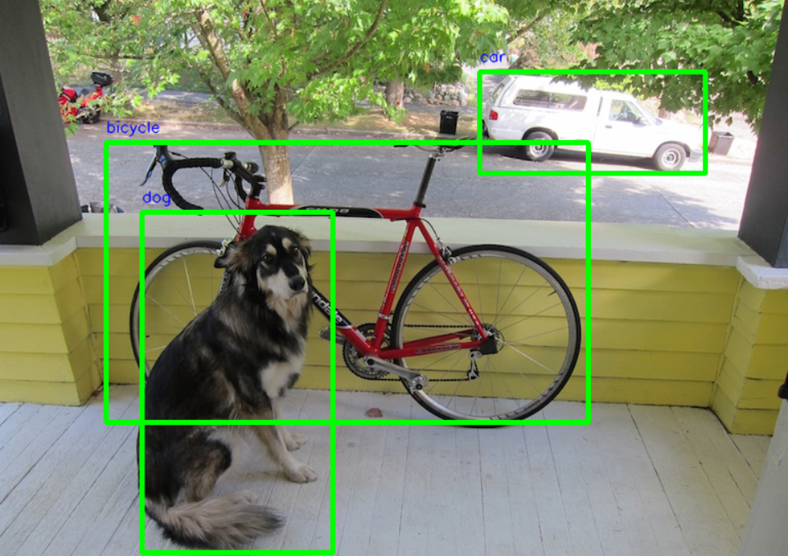
RESULTS
Demo Link
3/21/2024 Annual Review
10

